Slide 1
UNIT-1

Slide 2
Instruction set architecture of CPU
Complex Instruction Set Computer (CISC)
Typically used in desktop, laptop and servers.
b) Reduced Instruction Set Computer (RISC )
Used in micro controllers , that are used to build embedded systems.

Slide 3
The most common example of such CISC architecture are the Intel classes of processors which dominate the desktop, laptop and server markets.
More than 90% of the processors are made by Intel or some clones of those made by Intel. These are called CISC.

Slide 4
Instruction sets are very simple in RISC.
Easy to implement.
Most of the microcontrollers are based on RISC architecture.

Slide 5
Difference between RAM and ROM
RAM- Random Access Memory
volatile, means they retain the values only during the time the power is switched on, as soon as you switch off the power the data gets lost.
ROM – Read Only Memory
Non-volatile, once you store it even if you
switch off the power the program will not get destroyed.

Slide 6
Flash Memory
Non-volatile.
you can store some program, you could also change the program if you want, but if you switch off the power the program does not get destroyed.
nowadays there are microcontrollers which use technologies like flash memory

Slide 7
Classification of CPU Architecture
Two Types of Architecture
Von Neumann Architecture
Both instructions and data are stored in the same memory.
This model is followed in conventional computing systems.

Slide 8
Harvard Architecture
Instructions and data are stored in different memories.
Followed in microcontrollers, used for building embedded systems.
Instructions are stored in ROM.
Temporary data are in RAM.

Slide 9
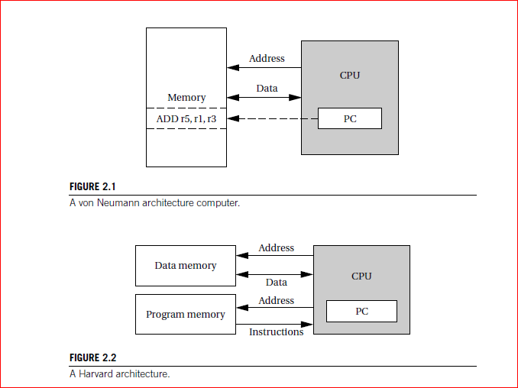

Slide 10
Drawback of Harvard Architecture
Require many buses.
lot of IO pins to interface the external devices
Advantages of Harvard Architecture.
faster and parallel data transfer features.

Slide 11
Instruction set characteristics
The instruction set of the computer defines the interface between software modules and the underlying hardware.
Fixed versus variable length.
Addressing modes.
Numbers of operands.
Types of operations supported

Slide 12
What is microprocessor
Entire CPU fabricated on single chip.
Consists of set of registers to store temporary data.
Consists of ALU where arithmetic and logical computations are done.
Consists of some mechanism to interface external devices through buses.
Consists of control unit that synchronizes the operation.

Slide 13
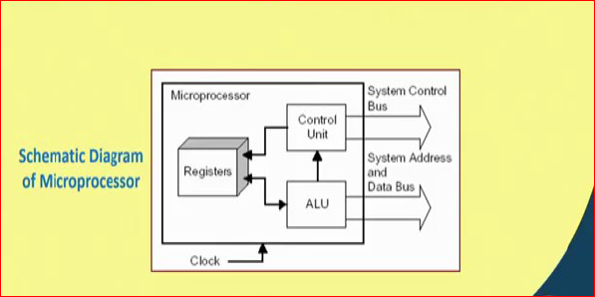

Slide 14
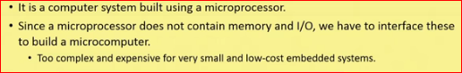
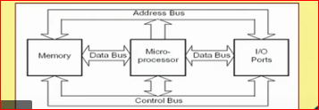
What is a Microcomputer

Slide 15
What is a Microcomputer
a microprocessor contains basically some registers, ALU and control; it does not contain any memory or any facility for IO.
To make a computer system we have to interface all these devices with the microprocessor.
It is a computer system built using microprocessor.

Slide 16
But, the trouble is that since you have to interface so many things around a microprocessor, the system becomes complex, bulky and also expensive.
In addition it also consumes significantly higher power.
It is fine if you use it for a high performance application like a desktop or a laptop, but not for embedded system applications were ultra low power, portability, small size these features are quite essential.

Slide 17
Microcontroller
A microcomputer is a computer system built around a microprocessor. Now, if the whole of the microcomputer we can shrink and put inside a single chip, we get a microcontroller.
microcontroller is basically a computer on a single chip, because it is on a single chip it is relatively very low cost and inexpensive. It is small, it also consumes very low power.

Slide 18
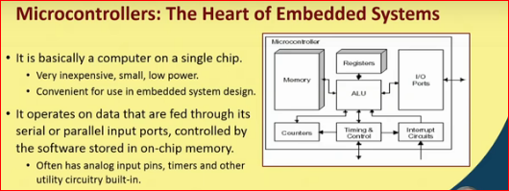

Slide 19
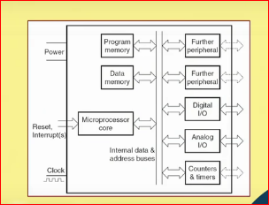
Detailed Circuit diagram of microcontroller

Slide 20
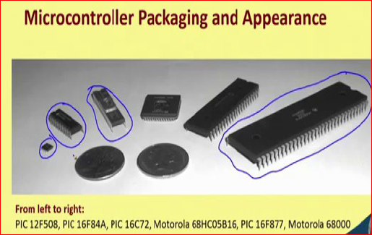

Slide 21
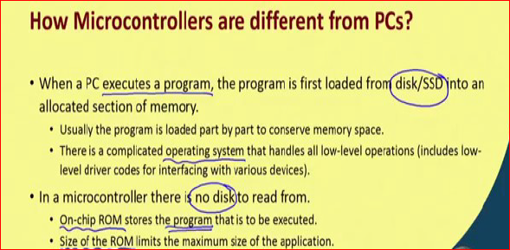
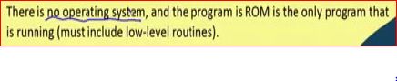

Slide 22
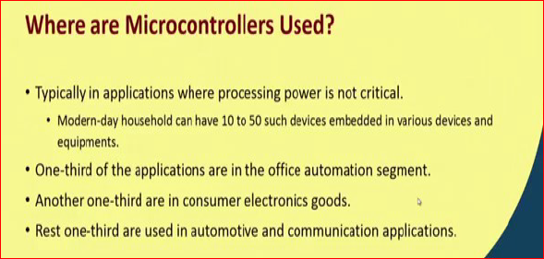

Slide 23
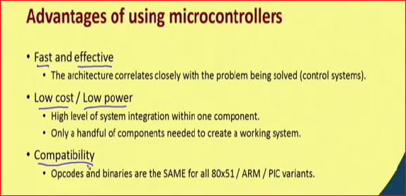

Slide 24
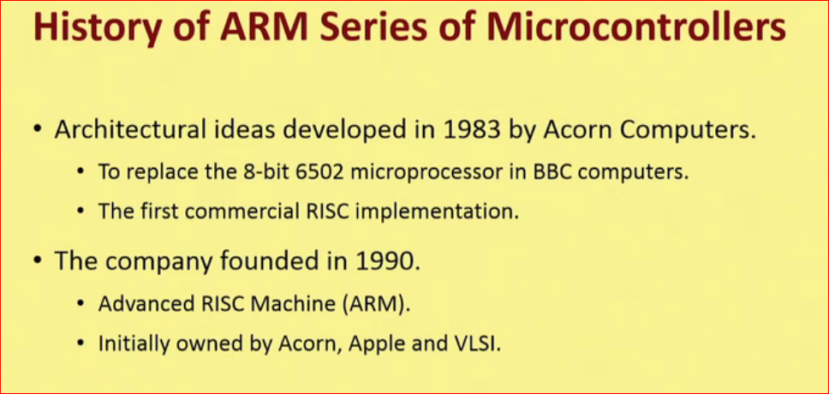
ARM Microcontroller

Slide 25
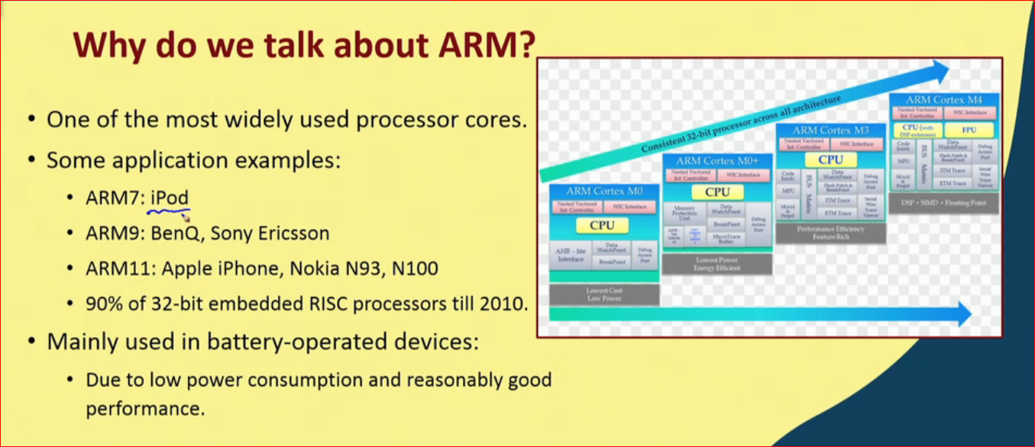

Slide 26
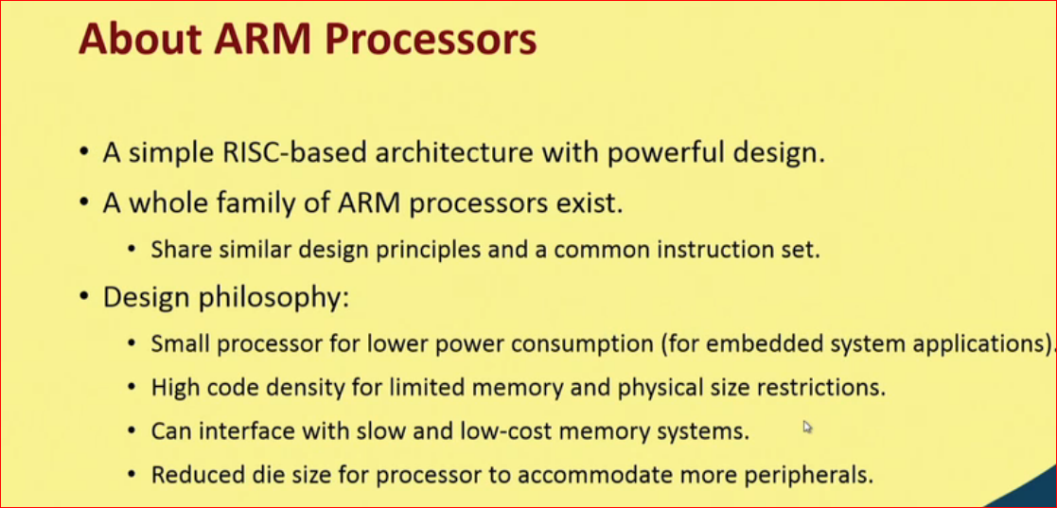

Slide 27
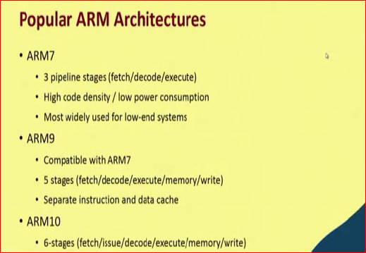

Slide 28
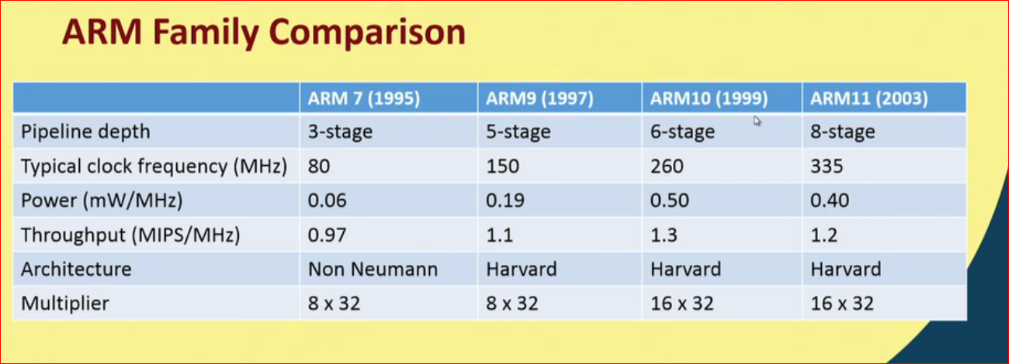

Slide 29
As a developer you need to develop or
design an embedded system, you will be having a hardware platform, a microcontroller
based system and you have to write software for it.
Today most of us develop the software in some high level language, either in C or in Python or in Java, but it is always good to know the lower level features of the processor in order to have an informed decision that which processor may be better for a particular application.

Slide 30
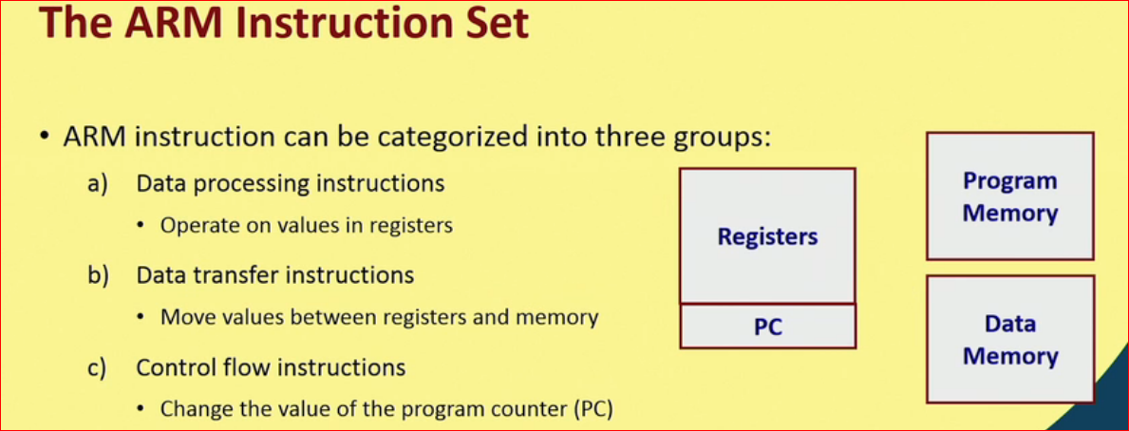

Slide 31
Most of the ARM features are RISC based.
Data processing instructions –carrying out various arithmetic and logic operations on data.
Here all data processing instructions operate only on registers.
Data transfer instructions-We can transfer from one register to another or we can transfer from register to data memory or data memory to
register.

Slide 32
control flow instruction- are those that will be
altering the value of PC in some way so that the normal sequence of instruction execution will be altered.

Slide 33
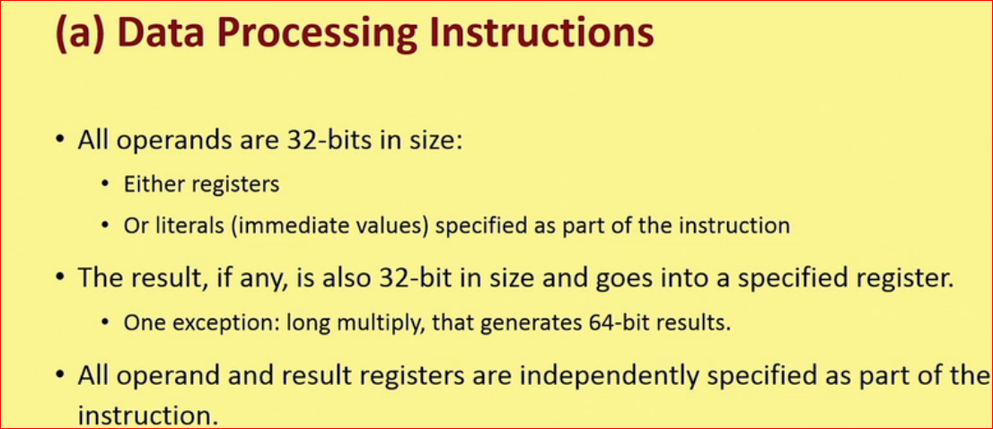

Slide 34
Registers are all 32-bit in size.
ALU inside the processor also has the capability of operating on 32-bit numbers.
some of the operands may be constants -- these
are called literals or immediate values.

Slide 35
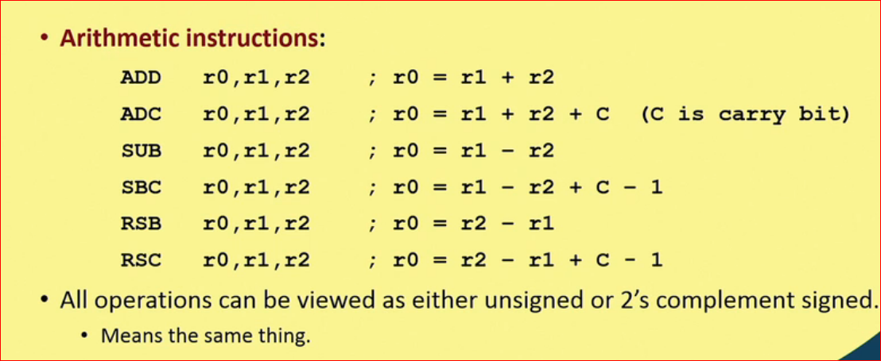

Slide 36
r0, r1, r2. The first one represents the
destination, the second and third indicates the two source operands.
ADC- Add with carry.
SBC-This takes care of the borrow during subtraction operation.
RSB -Reverse subtract.

Slide 37
ADD r0,r1,#2--sets r0 to r12.
The MUL instruction multiplies two values, but with some restrictions:No operand may
be an immediate,and the two source operands must be different registers.
MLA r0,r1,r2,r3 -sets r0 to the value r1*r2+r3.
Multiply Accumulate Operation.

Slide 38
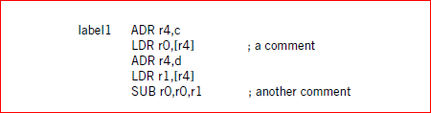
Assembly Languages

Slide 39
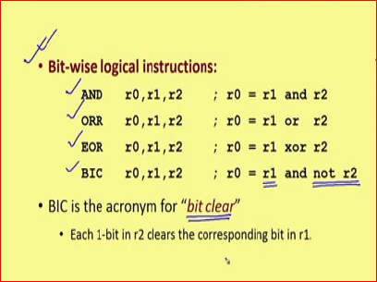

Slide 40
BIC- Bit Clear .
The actual meaning is the register r1 is ANDed with the complement of r2; you take a NOT operation and then do an AND.
So, that in r2 whichever bit is 1, if you do NOT those bits will become 0; if you do AND with r1 those corresponding bits of r1 will become 0. So, wherever in r2 you have 1 those corresponding bits in r1 will be made 0;

Slide 41
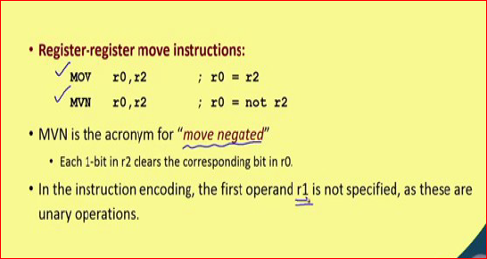

Slide 42
Processor and memory organization
ARM7 is a von Neumann architecture machine, while ARM9 uses a Harvard architecture.
TheARM architecture supports two basic types of data:
■ The standardARM word is 32 bits long.
■ The word may be divided into four 8-bit bytes.

Slide 43
ARM7 allows addresses up to 32 bits long.
the word 0 in the ARM address space is at location 0, the word 1 is at 4,the word 2 is at 8,and so on. (As a result, the PC is incremented by 4).

Slide 44
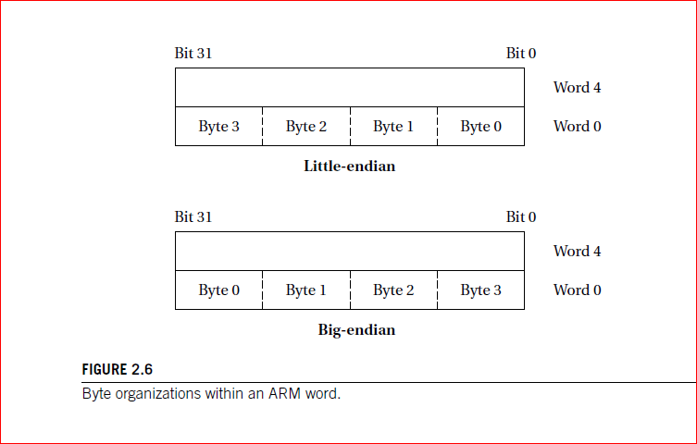

Slide 45
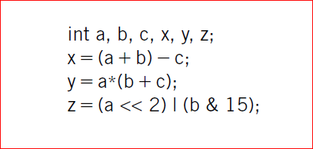
Sample C code

Slide 46
In the ARM processor, arithmetic and logical operations cannot be performed directly on memory locations.
ARM is a load-store architecture—data
operands must first be loaded into the CPU and then stored back to main memory to save the results

Slide 47
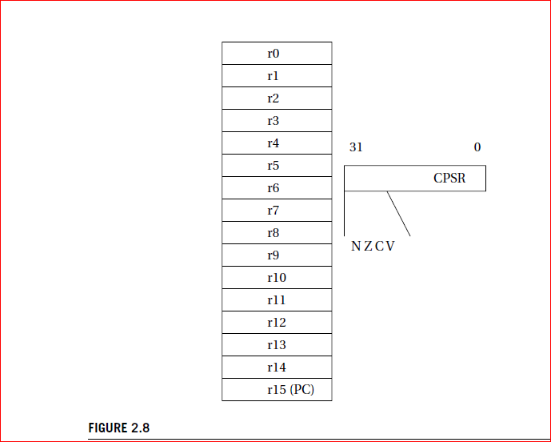
current
program status register

Slide 48
The negative (N) bit is set when the result is negative in two’s-complement arithmetic.
■ The zero (Z) bit is set when every bit of the result is zero.
■ The carry (C) bit is set when there is a carry out of the operation.
■ The overflow(V) bit is set when an arithmetic operation results in an overflow.

Slide 49
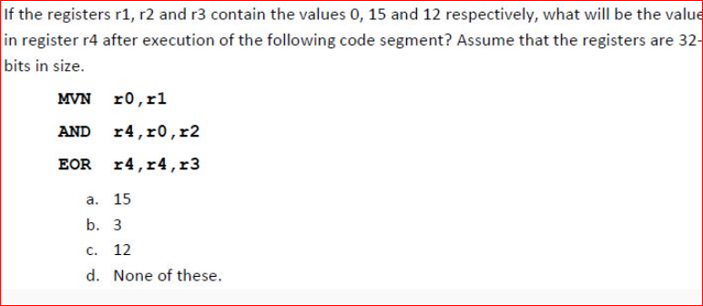
SOLVE

Slide 50
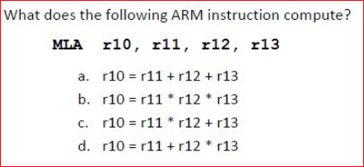

Slide 51
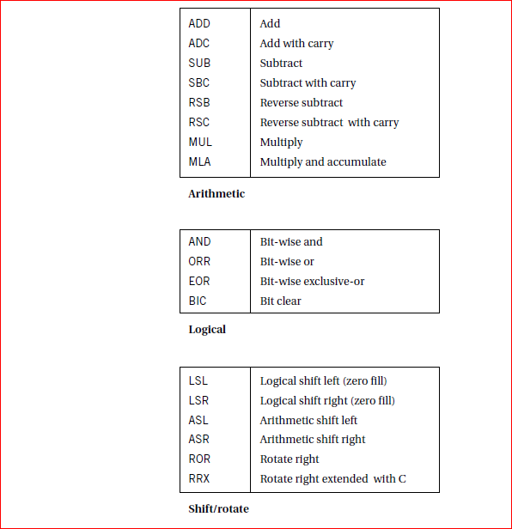
ARM Data Instructions

Slide 52
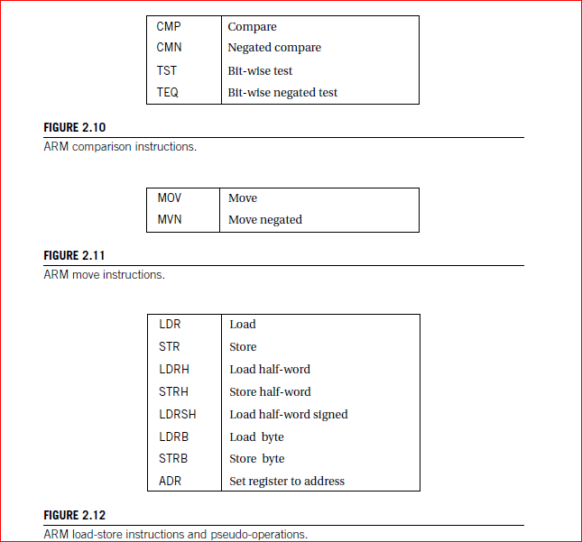

Slide 53
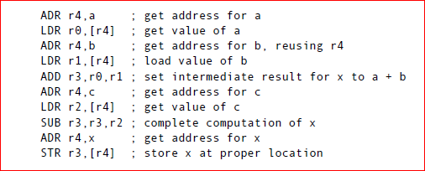
Write assembly language code for x=(a+b)-c

Slide 54
Write assembly language code for y=(a*b)+c

Slide 55
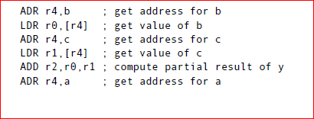
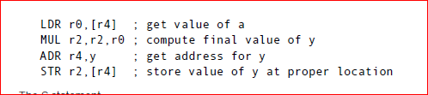

Slide 56
Flow of Control
The B (branch) instruction is the basic mechanism inARM for changing the flow of
control.
B #100 --will add 400 to the current PC value.

Slide 57
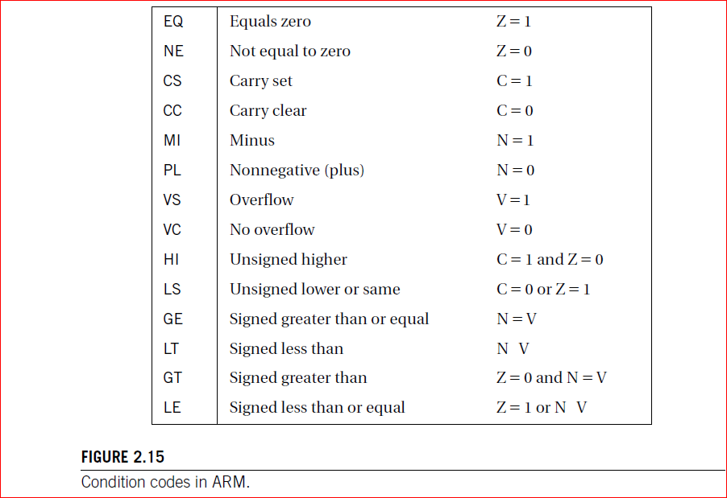

Slide 58
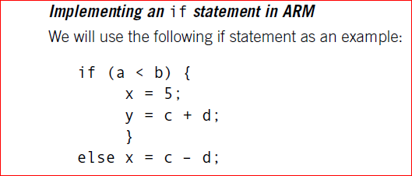

Slide 59
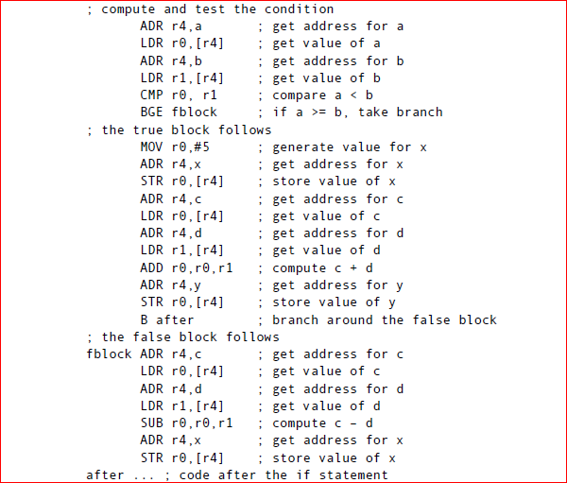

Slide 60
CPU
Input and output mechanisms.
■ Supervisor mode, exceptions, and traps.
■ Memory management and address translation.
■ Caches.
■ Performance and power consumption of CPUs.

Slide 61
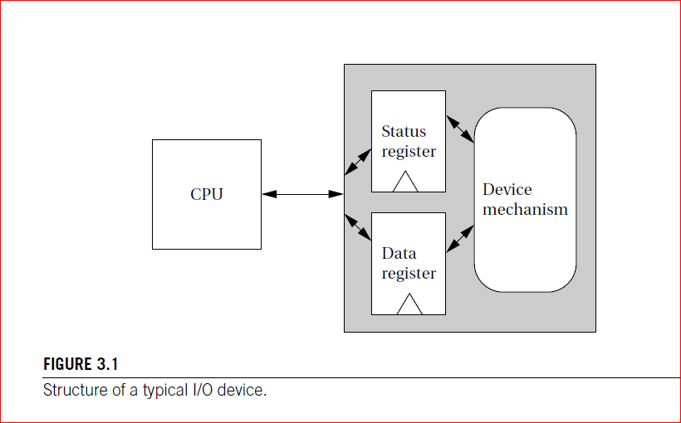
PROGRAMMING INPUT AND OUTPUT

Slide 62
Input and Output Primitives
Microprocessors can provide programming support for input and output in two ways:
I/O instructions
memory-mapped I/O.

Slide 63
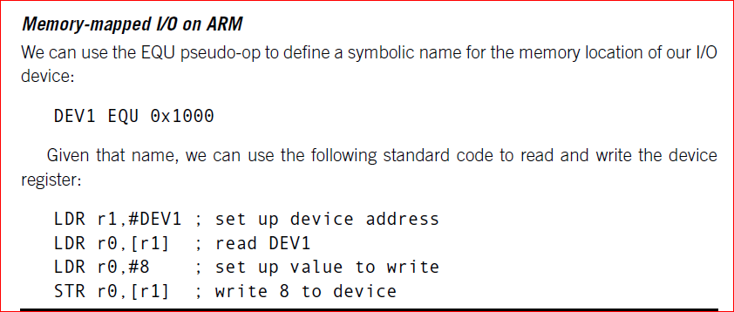

Slide 64
Three types of data transfers in ARM
Single register Load and store.
Multiple Register Loads and stores.
Single Register memory swap.
For implementing Locks.
Exchanging the values of a register and a memory location in a single instruction

Slide 65
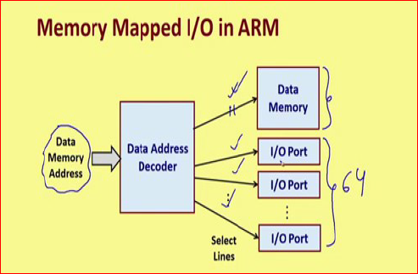

Slide 66
Whenever some data are accessed, data memory address is generated by the processor.
There is a decoder which decodes this address and it selects the corresponding memory location.
But in memory mapped IO, IO ports are also regarded as memory locations.

Slide 67
Suppose there are 6 IO ports.
Using 6 ports . Address 2⁶ =64 IO devices.
We are assuming that there are 64 memory locations also.
The same decoder depending on the address will be selecting either one of the data memory addresses or one of these ports.

Slide 68
So, the IO ports or IO devices are treated as memory locations. This is the basic concept behind memory mapped IO.
There is no separate instruction for doing input and output.

Slide 69
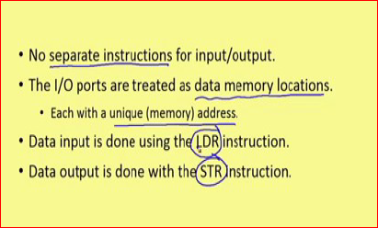

Slide 70
When you want to read some data from an input device, you will be using load instruction;
when you want to write some data into an output device you will be using store instruction. That is how ARM handles it.

Slide 71
Busy-wait I/O
Devices are typically slower than the CPU and may require many cycles to complete an operation.
If the CPU is performing multiple operations on a single device,such as writing several characters to an output device, then it must wait for one operation to complete before starting the next one.
Asking an I/O device whether it is finished by
reading its status register is often called polling

Slide 72
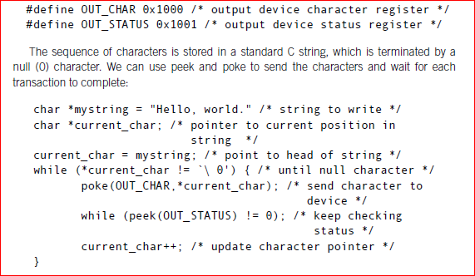
Busy-wait I/O programming

Slide 73
The status register’s value is 1 when the device is busy writing and 0 when the write transaction has completed

Slide 74
Interrupts
Instead of having the software continually poll the hardware — which wastes CPU time — an interrupt is the preferred method of “finding out” that the hardware requires some kind of service. The software that handles the interrupt is therefore typically called an Interrupt Service Routine (ISR).
Allows parallelism.
allows devices to signal the CPU and to force execution of a particular piece of code.
When an interrupt occurs, the program counter’s value is changed to point to an interrupt handler routine.

Slide 75
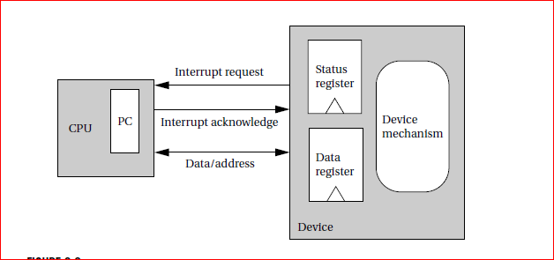

Slide 76
Busy-wait I/O is extremely inefficient.
inefficient—the CPU does nothing but test the device status while the I/O transaction is in progress.
the CPU could do useful work in parallel with the I/O transaction.

Slide 77
Priorities and Vectors
there must be some mechanism for allowing multiple devices to interrupt.
interrupt priorities allow the CPU to recognize some interrupts as more important than others, and
interrupt vectors allow the interrupting device to specify its handler.

Slide 78
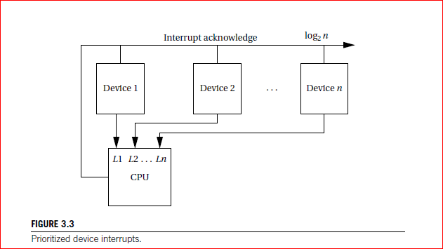

Slide 79
Most CPUs use a set of signals that provide the priority number of the winning interrupt in binary form.
interrupt level 7 requires 3 bits rather than 7.
A device knows that its interrupt request was accepted by seeing its own priority number on the interrupt acknowledge lines

Slide 80
How do we change the priority of a device? Simply by connecting it to a different interrupt request line. This requires hardware modification.
The priority mechanism must ensure that a lower-priority interrupt does not occur when a higher-priority interrupt is being handled.
The decision process is known as masking.

Slide 81
When an interrupt is acknowledged, the CPU stores in an internal register the priority level of that interrupt.
the new request is acknowledged only if it has higher priority than the currently pending interrupt.
The highest-priority interrupt is normally called the nonmaskable interrupt (NMI).
The NMI cannot be turned off and is usually reserved for interrupts caused by power failures.

Slide 82
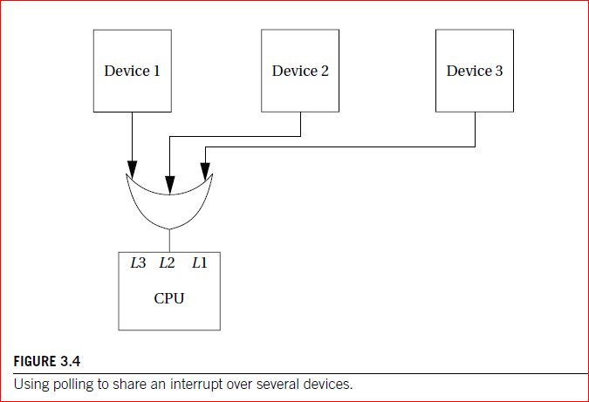
Most CPUs provide a relatively small number of interrupt priority levels, such as eight.

Slide 83
I/O with prioritized interrupts

Slide 84
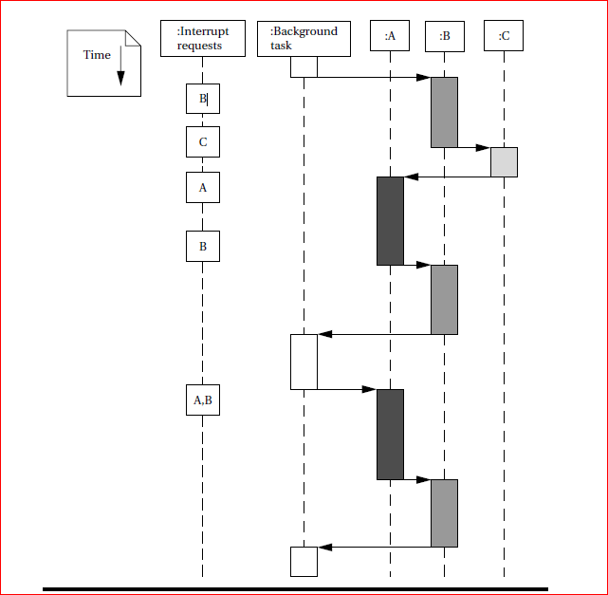

Slide 85
microcontrollers make use of interrupt vector tables to find the starting address of ISR routines.
embedded programming, vector means memory address.
a vector table is a table that contains memory addresses.
The interrupt vector table is a table of memory addresses of interrupt/exception handler routines.
it defines where the code of a particular interrupt/exception routine is located in microcontroller memory.

Slide 86
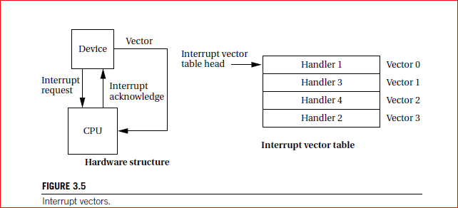
Vectors in handling Interrupts(IVT)

Slide 87
understanding of the interrupt mechanism
Once a device requests an interrupt, some steps are performed by the CPU, some by the device, and others by software.
CPU The CPU checks for pending interrupts at the beginning of an instruction.
It answers the highest-priority interrupt, which has a higher priority than that given in the interrupt priority register.

Slide 88
Device --The device receives the Acknowledgment and sends the CPU its
interrupt vector.
The CPU looks up the device handler address in the interrupt vector table using the vector as an index. A subroutine-like mechanism is used to
save the current value of the PC and possibly other internal CPU state, such as general-purpose registers.

Slide 89
The device driver may save additional CPU state. It then performs the required operations on the device. It then restores any saved state and executes the interrupt return instruction.
The interrupt return instruction restores the PC and other automatically saved states to return execution to the code that was interrupted.

Slide 90
Overhead associated with the interrupt mechanisms.
The interrupt itself has overhead similar to a subroutine call. Because an interrupt
causes a change in the program counter, it incurs a branch penalty. In addition, if the interrupt automatically stores CPU registers, that action requires extra cycles, even if the state is not modified by the interrupt handler.

Slide 91
In addition to the branch delay penalty, the interrupt requires extra cycles to
acknowledge the interrupt and obtain the vector from the device.
The interrupt handler will, in general, save and restore CPU registers that were not Automatically saved by the interrupt.

Slide 92
The interrupt return instruction incurs a branch penalty as well as the time required to restore the automatically saved state.

Slide 93
SUPERVISOR MODE
Hardware checks required to ensure that the programs do not interfere with each other.
User programs should not have an access to operating system.
One user program should not overwrite another user program space.
Supervisor mode helps in preventing applications from corrupting the data of the operating system.

Slide 94
Supervisor mode handles different types of commands but mostly deals with privileged instructions. This mode is used by the operating system and has full access to all the system components.
Normal programs run in user mode.
The supervisor mode has privileges that user modes do not.
ARM implements Supervisor mode.

Slide 95
The ARM instruction that puts the CPU in supervisor mode is called SWI.
SWI CODE_1

Slide 96
Exceptions
An exception is an internally detected error.

